Slide 1
View from the Commons: a new Parliament
Judith Boyce
House of Commons Select Committee Team
November 2024

Slide 2
Contents
The end of a Parliament
The start of a Parliament
Some features of the new House of Commons
Select committees
Private Members’ Bills
Modernisation of the Commons?

Slide 3
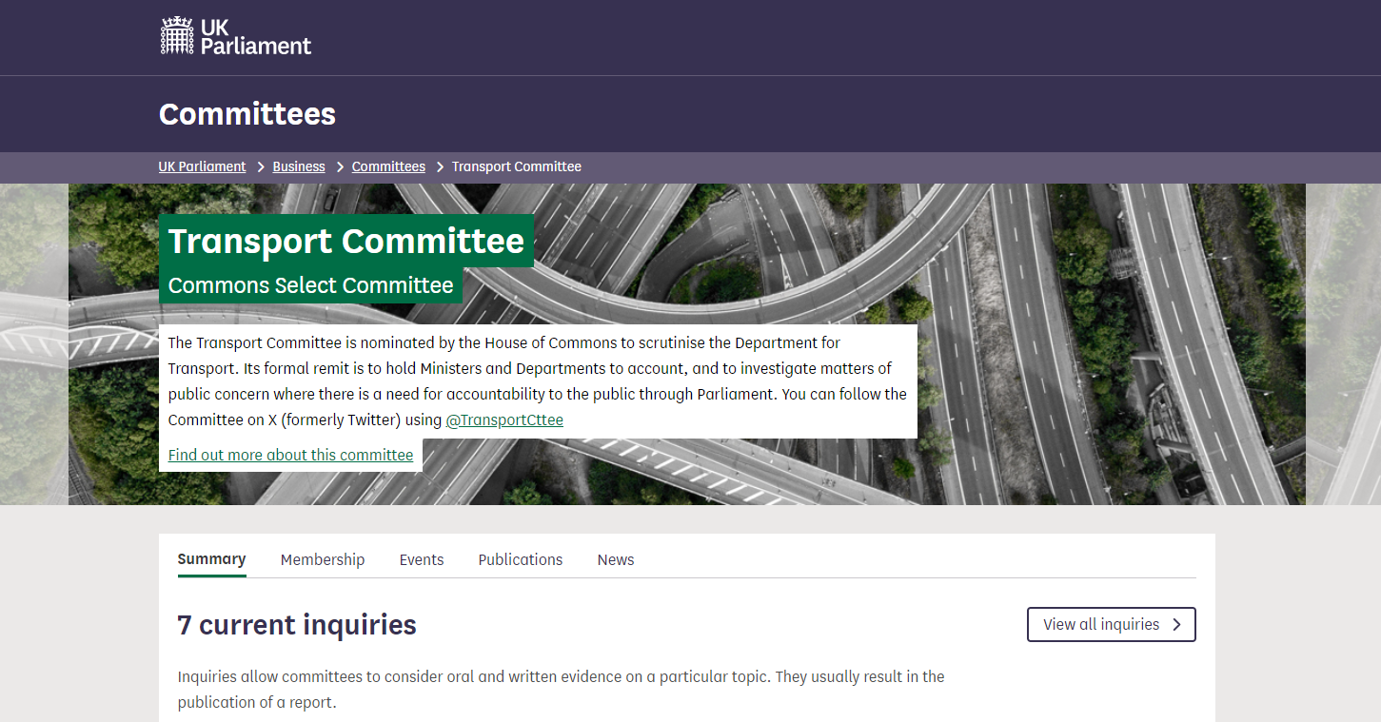

Slide 5
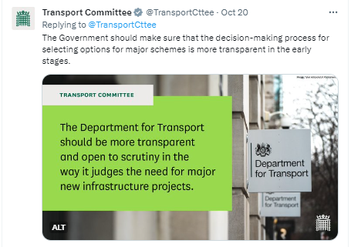
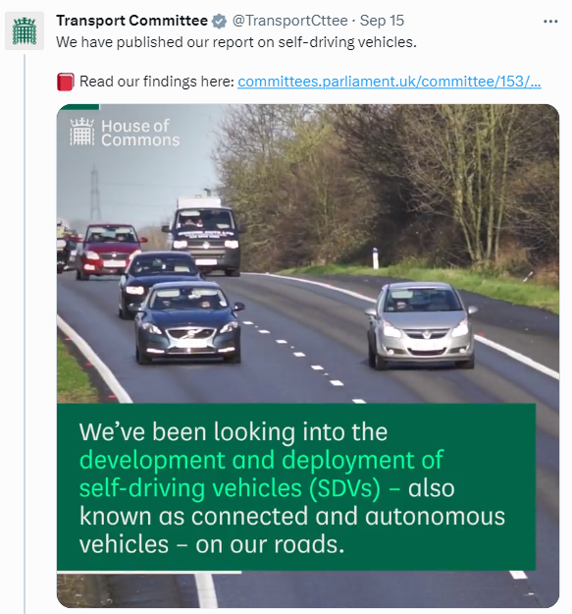
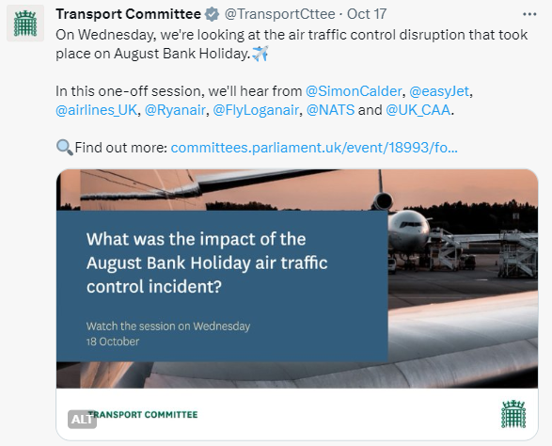
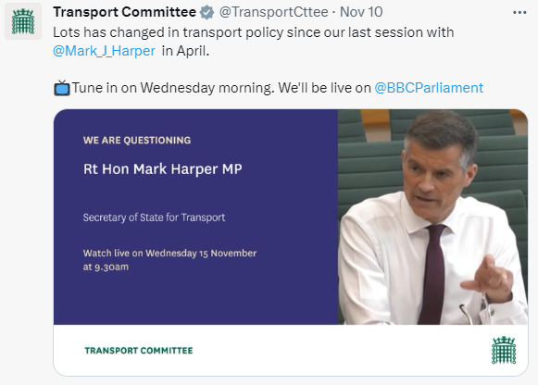

Slide 7
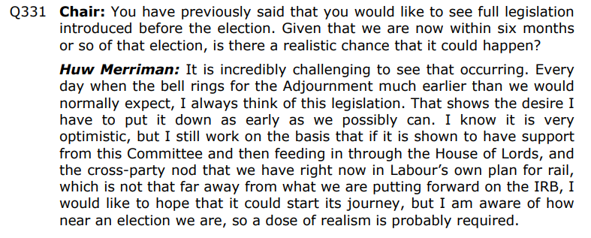
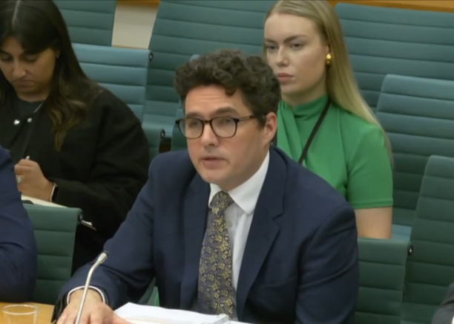

Slide 8
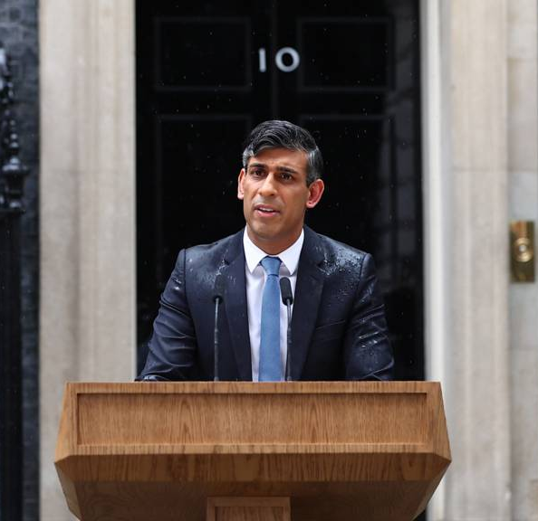

Slide 9
Election called
‘Wash up’
Parliament prorogued
Parliament dissolved
25 days to polling day
Weds 22 May
Friday 24 May
Thurs 30 May
Thurs 4 July

Slide 10
Effect of the wash-up
Parliamentary Questions and Early Day Motions
Bills:
Government Bills
Private Members’ Bills
Select committee inquiries

Slide 11
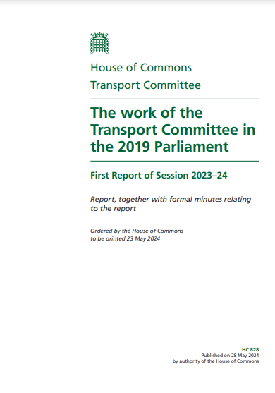
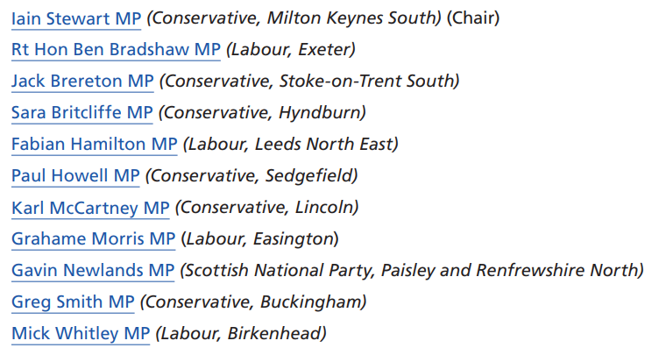

Slide 12
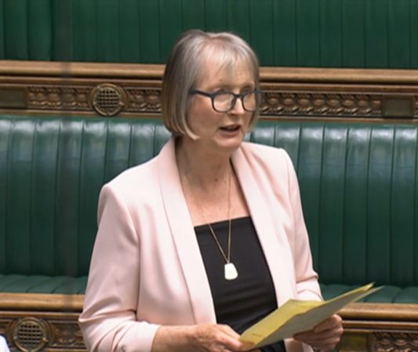
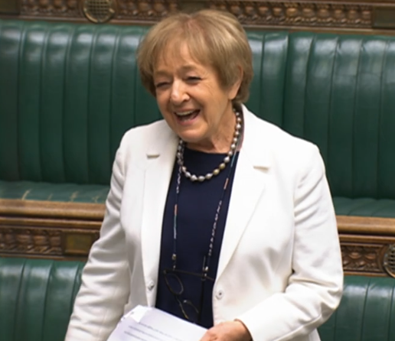
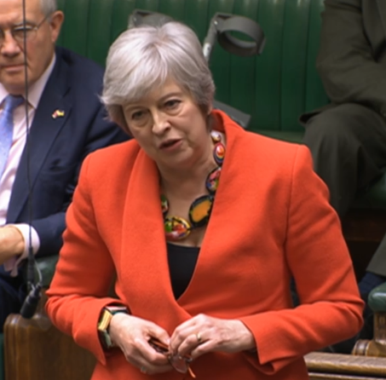
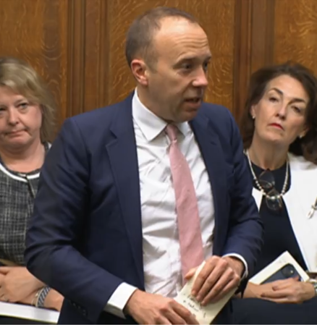
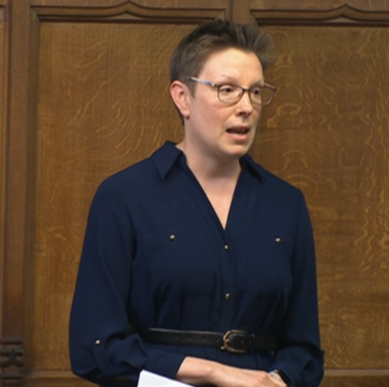
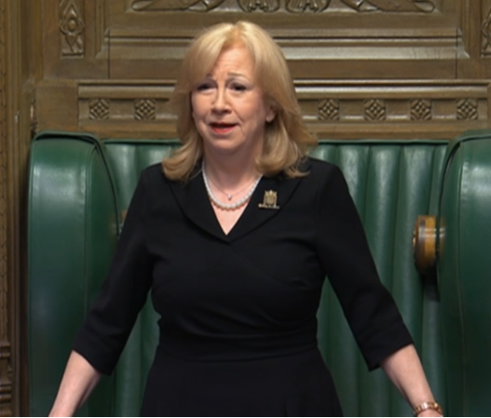
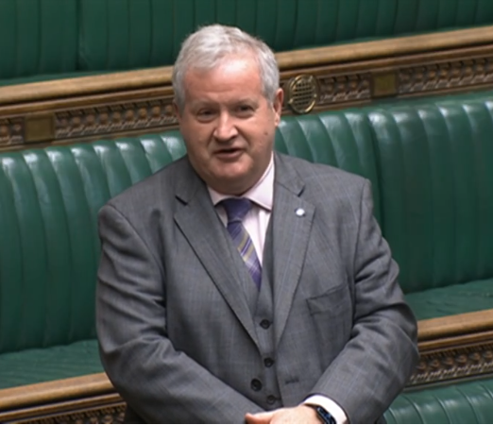

Slide 13
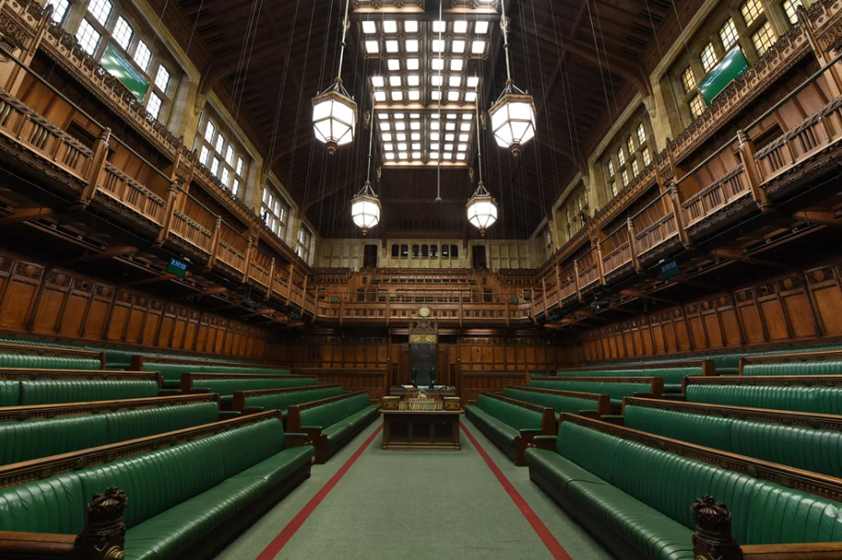

Slide 14
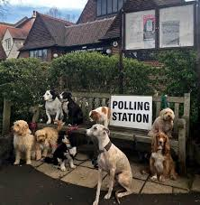
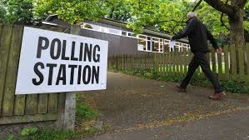
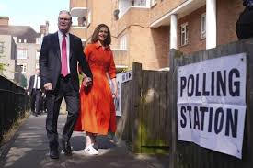

Slide 15
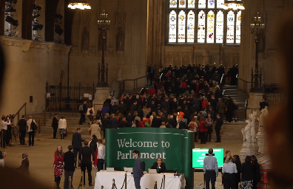
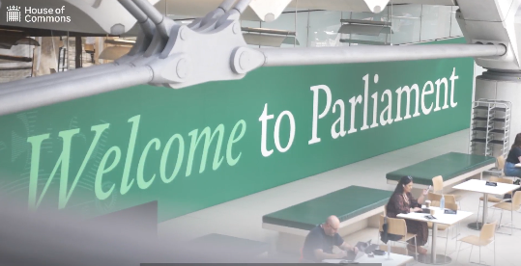
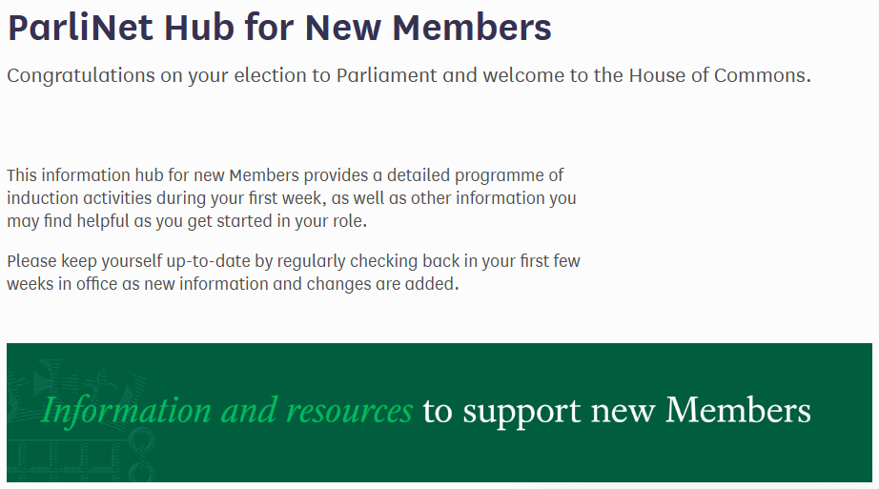

Slide 16
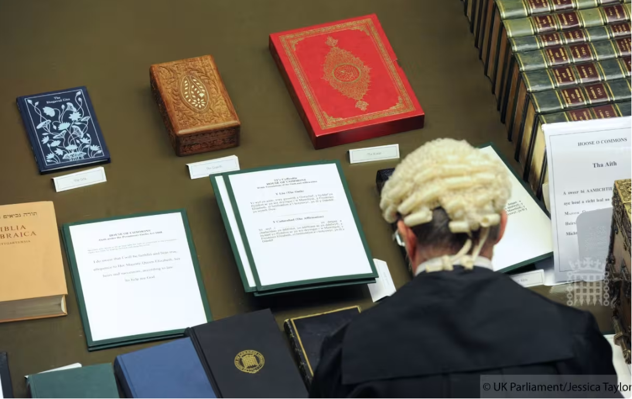
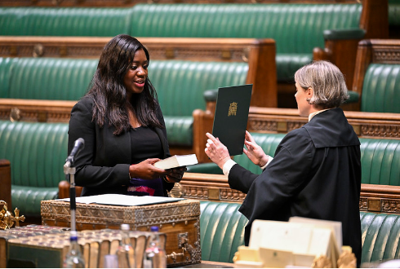
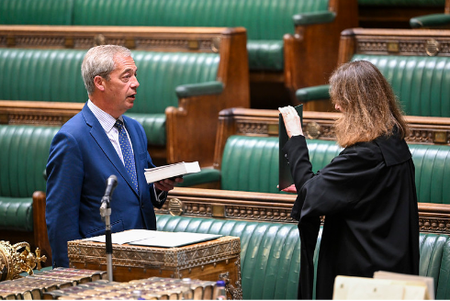
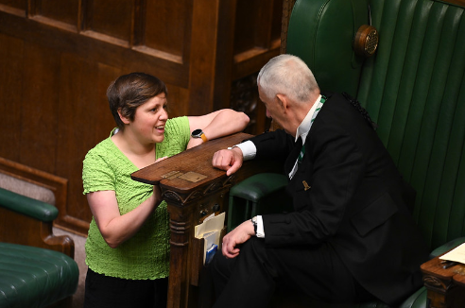

Slide 17
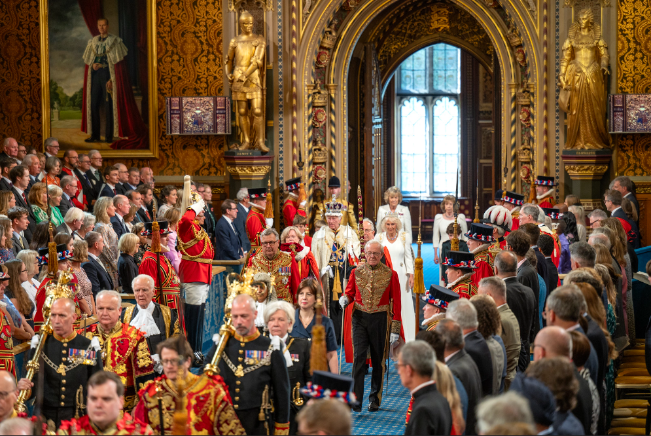
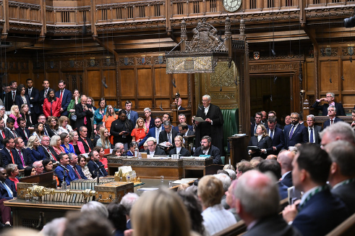

Slide 18
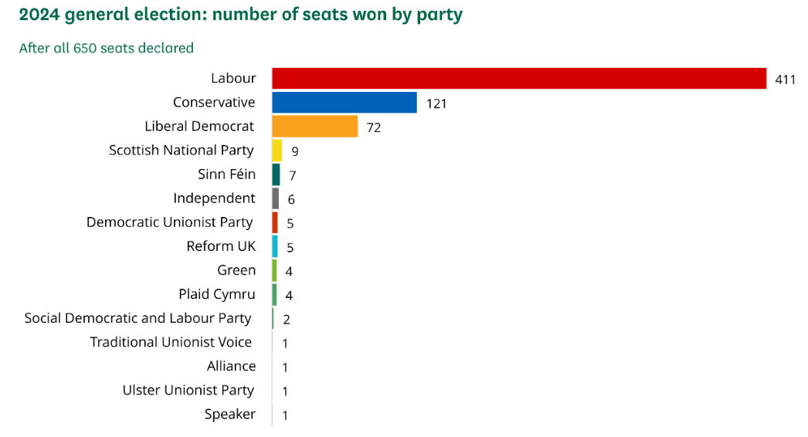

Slide 19
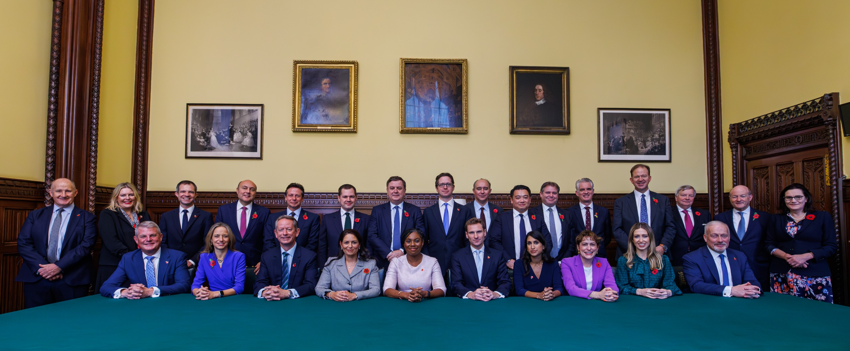

Slide 20
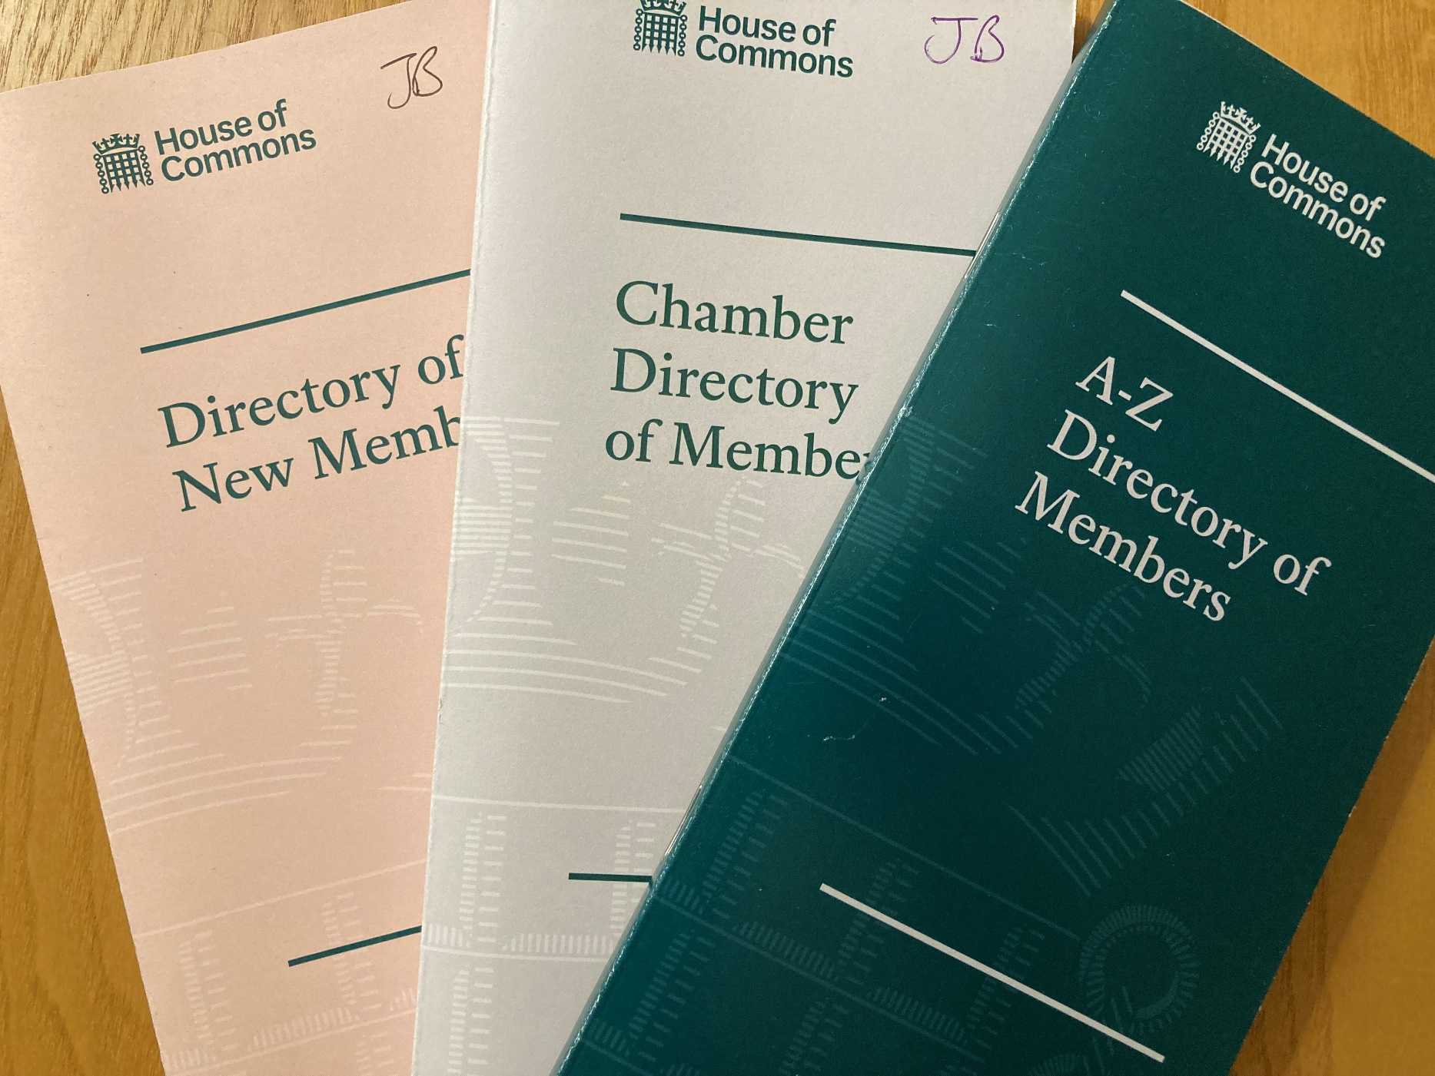

Slide 21
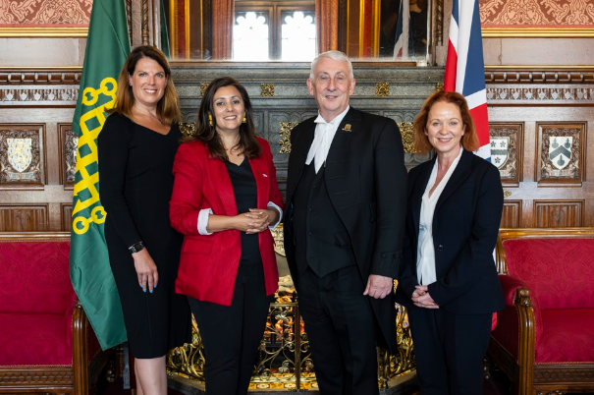

Slide 22
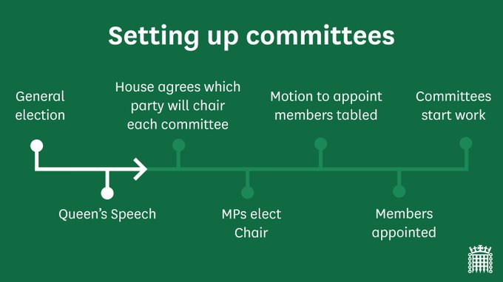
State Opening

Slide 23
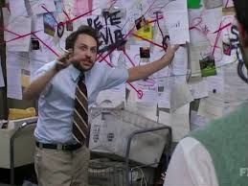

Slide 24
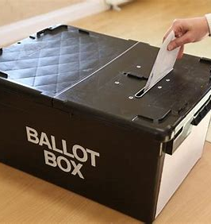
Electing Committee Chairs
Chairs of all Commons departmental committees are elected by MPs
The House agreed which parties should chair which committees
Candidates needed a minimum level of support from their own party
Alternative vote system
Elections on 11 September

Slide 25
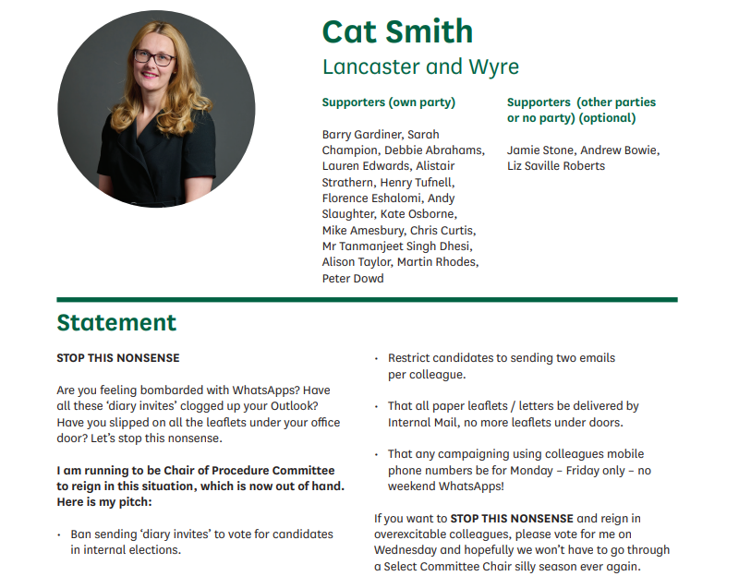

Slide 26
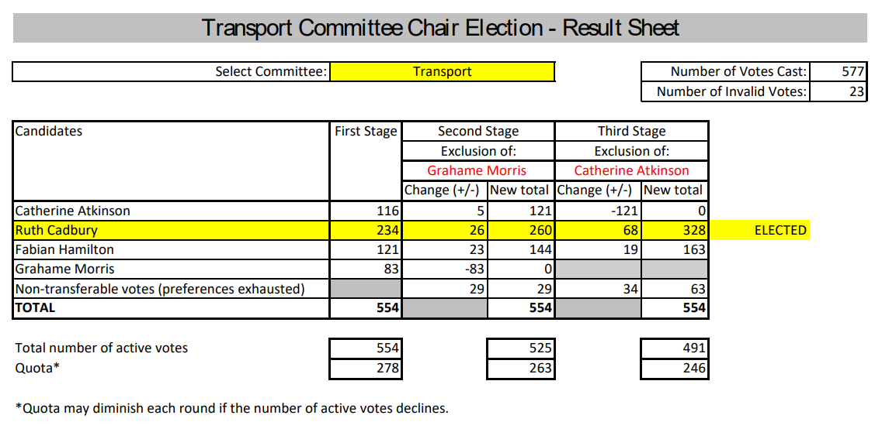

Slide 27
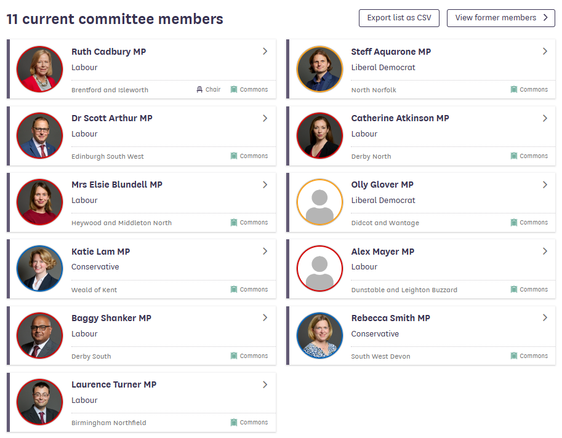

Slide 28
What might the new Committee do?

Slide 29
What might the new Committee do?
Regular scrutiny and accountability hearings
Respond to events
Scrutinise policy priorities of the new Government?
Address policy topics being ‘neglected’ by new Government?
Suggest future policy priorities for the Government?
Continue work from last Parliament?

Slide 30
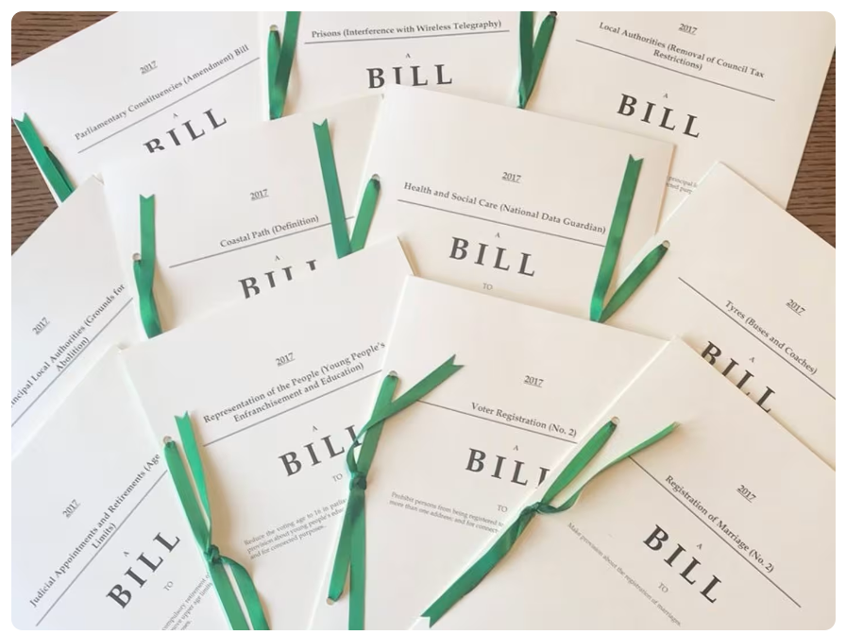

Slide 31
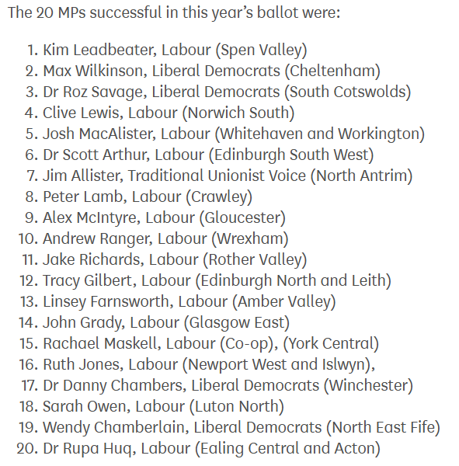

Slide 33
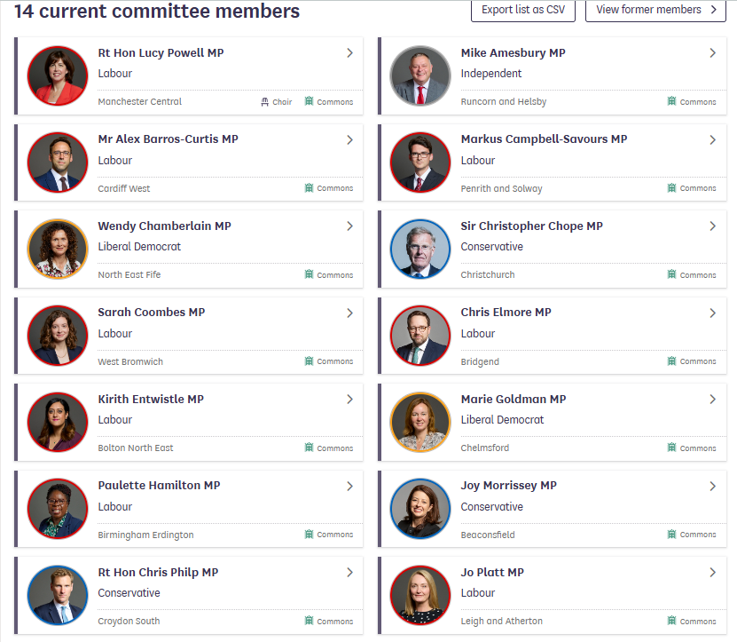
Three ‘strategic aims’:
driving up standards;
improving culture and working practices; and
reforming working procedures to make the House of Commons more effective

Slide 34
Thank you

