Slide 1
Elections in NI

Slide 2
12 Elections or referendums since 2014.
2015/2017/2019/2024 General Elections.
A lot of political instability.

Slide 3
Turnout
57% turnout, which was down from 62% in 2019.
Northern Ireland’s lowest turnout in our history.
The lowest turnout was in 2018, just under 58%.
Reflective of the certain outcome across the water.
Also narrative of a boring campaign.

Slide 4
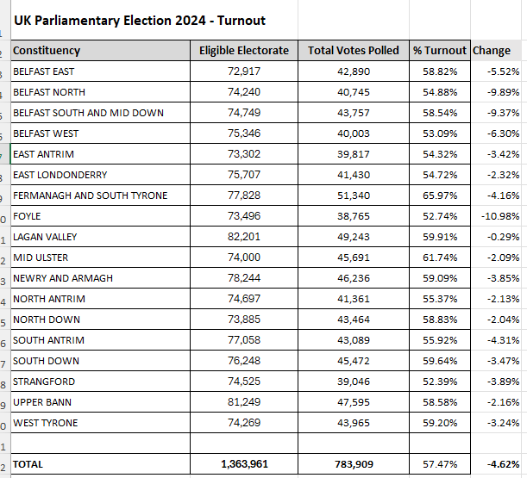

Slide 5
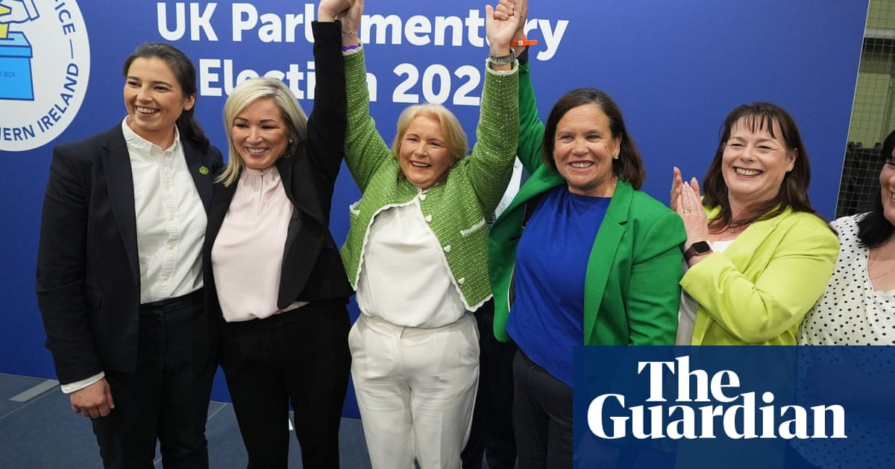
Sinn Fein
SF had the strongest day of all the parties.
Polled 27% of the vote.
Increased majorities in all 7 of their seats.
For the first time got more seats than any other party at Westminster.
Not their best vote share ever.

Slide 6
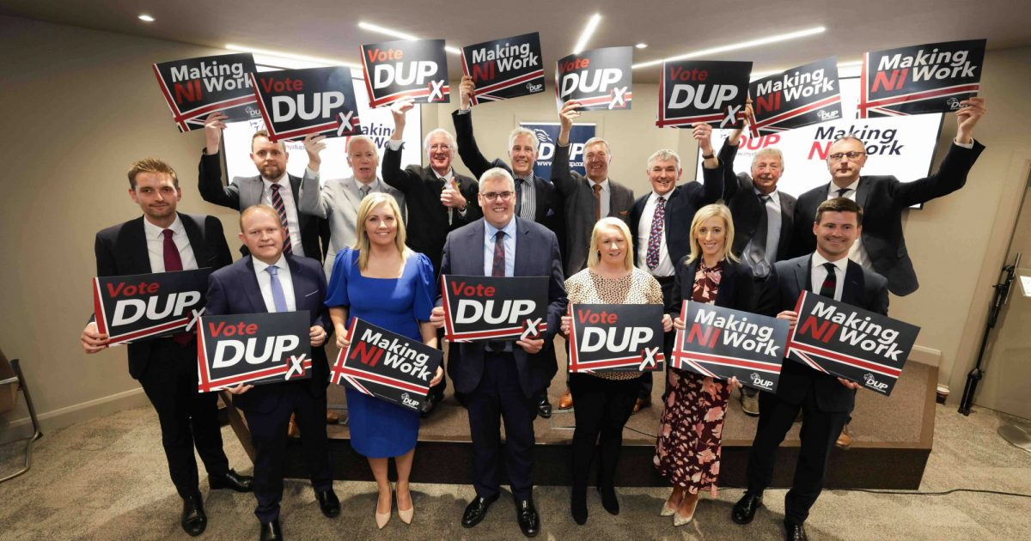
DUP
Party had been the largest at Westminster since 2005.
DUP back to where they were in 2001.
Lost three seats.
North Antrim ended the 54 year Paisley dynasty.
South Antrim was a heavy defeat.
Lagan Valley.
Two positives: East Belfast and Upper Bann.
Near Miss in East Derry and East Antrim.

Slide 7
Alliance
Mixed bag-Alliance surge is over.
Vote share down.
Gained Lagan Valley
Lost North Down by a big margin.
Party failed to make inroads elsewhere.
North Antrim and South Down show issues for 2027.

Slide 8
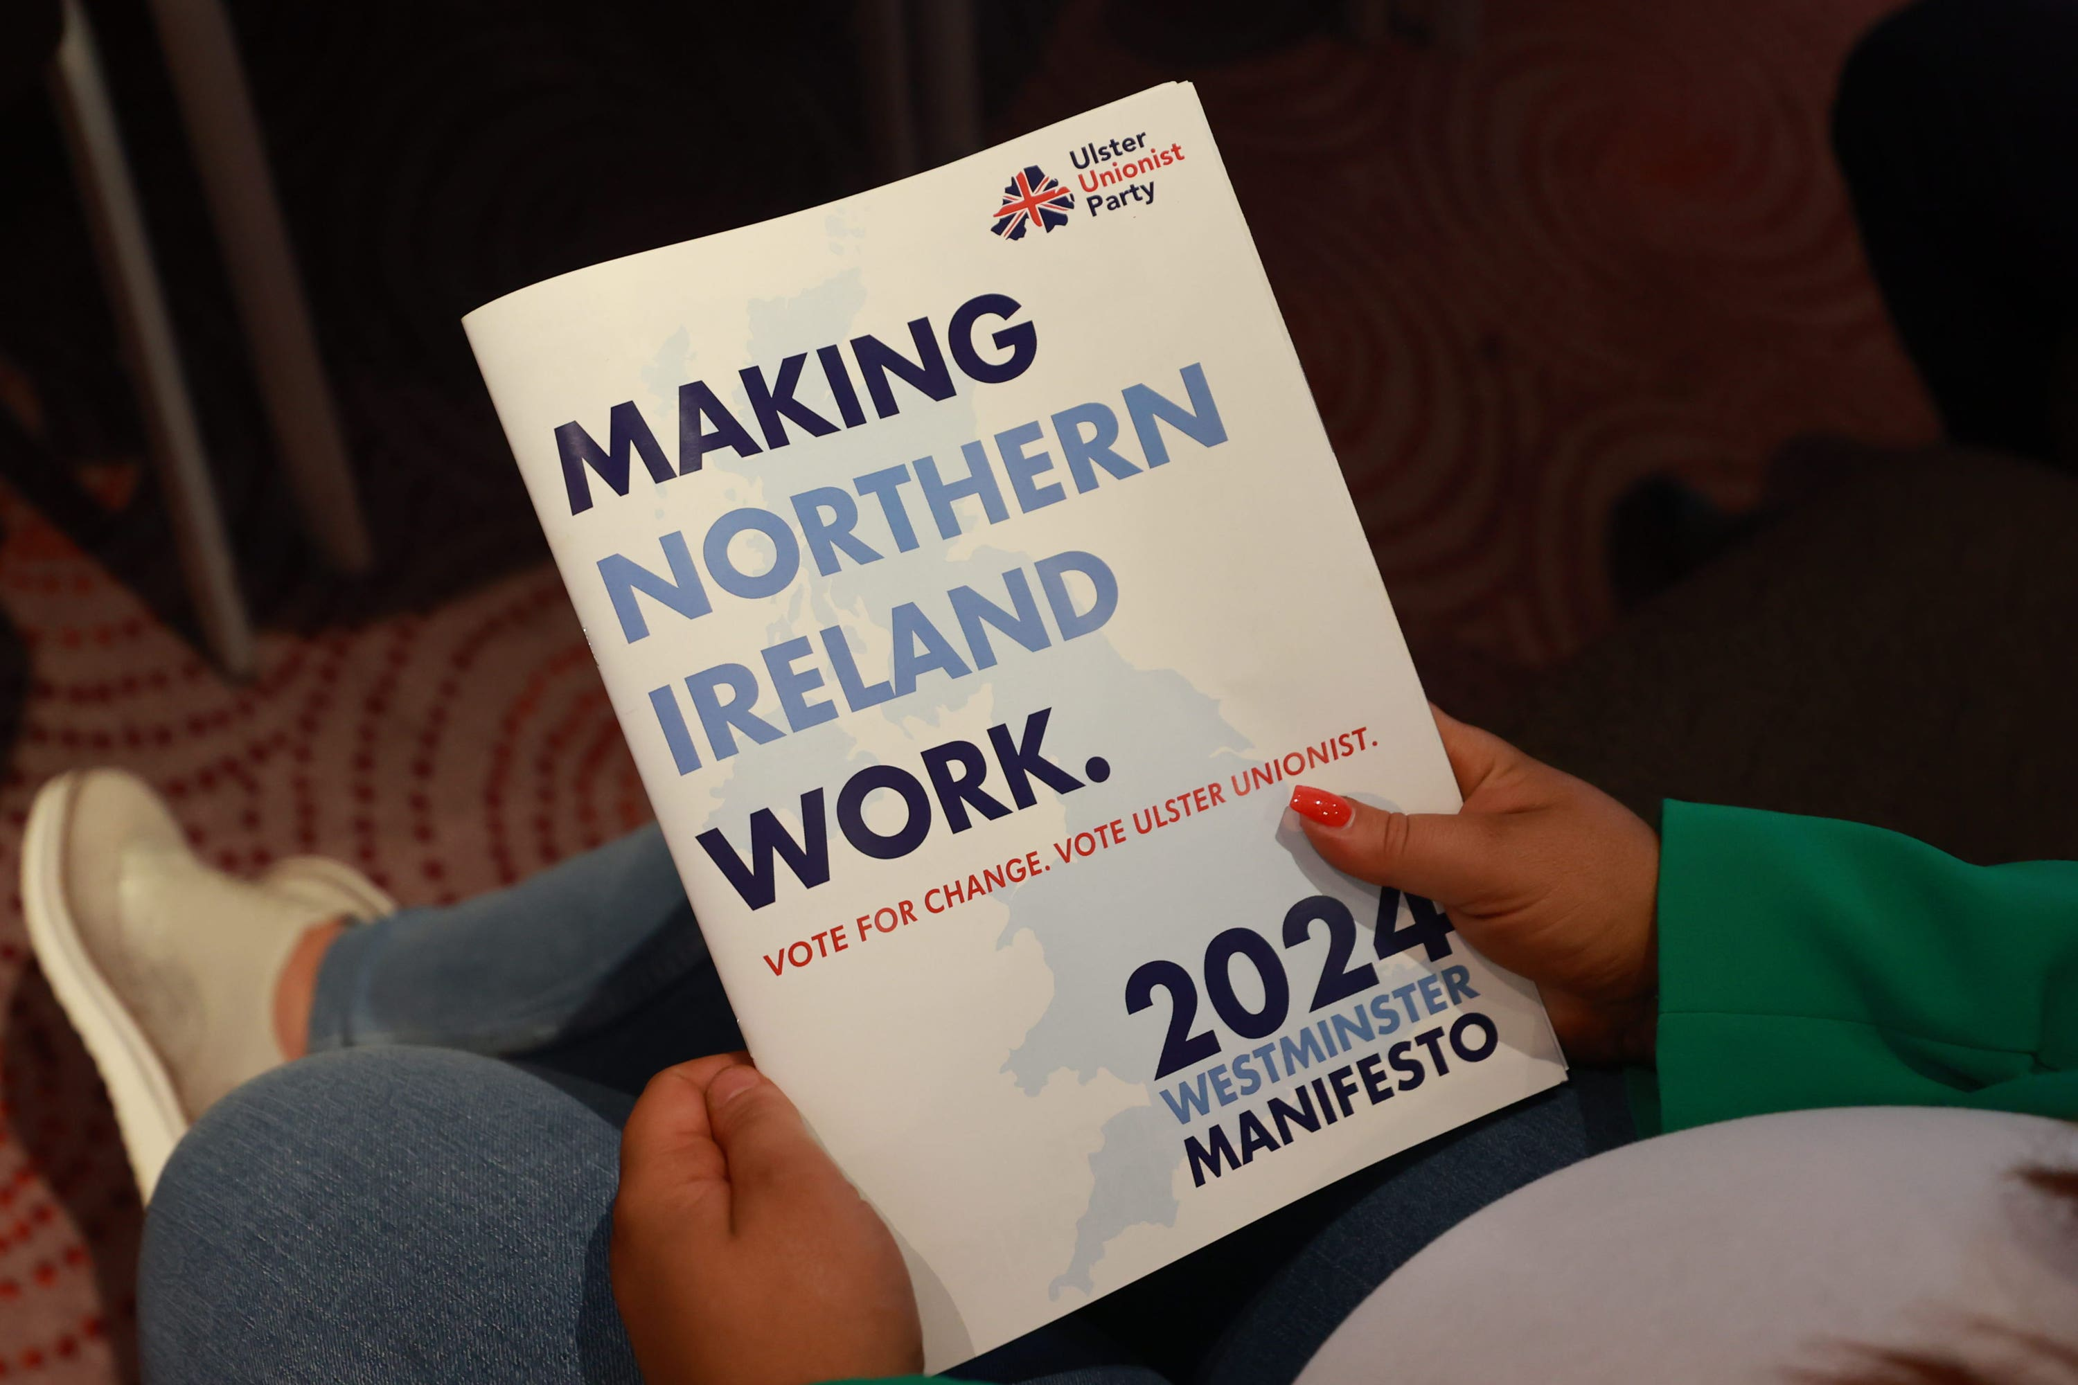
UUP
Back in the House of Commons for first time since 2017.
South Antrim was a real success.
East Antrim shows promise for 2029.
FST was a big disappointment.
Vote share marginally up.

Slide 9
SDLP
Kept their 2 seats. Swings away in Foyle.
Worst vote share in SDLP’s history at Westminster
South Belfast and Mid Down was a success.

Slide 10
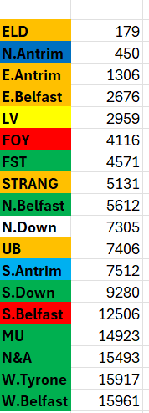

Slide 11
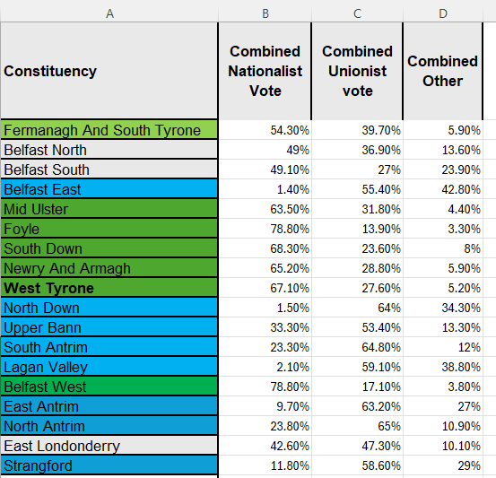

Slide 12
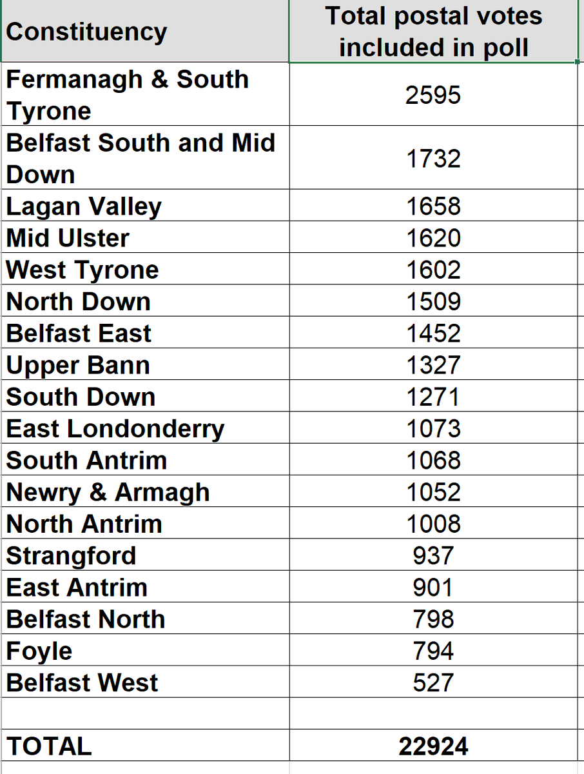
Postal votes
They show 89% (22,924) of postal votes issued ended up being included in the poll. 8,627 Proxy Votes were issued. FST had the highest number of postal votes 2,595. Also highest number of Proxy votes 1,364.

Slide 13
Sinn Fein took 67% of the pro UI vote SDLP took just under 28%
For the pro Union party vote #ge24 DUP got over 54% UUP got 30% TUV got over 15%
How strong is the West for Sinn Fein? 34% of their vote is in three constituencies (FST/MU/WT). The Sinn Fein average vote here was 51.2%. This is against an NI wide vote of 27%. #GE24
Nearly 24% of the TUV's total vote is with their leader in North Antrim. #GE24
How strong is the West for Sinn Fein? 34% of their vote is in three constituencies (FST/MU/WT). The Sinn Fein average vote here was 51.2%. This is against an NI wide vote of 27%. #GE24
17.2% of the UUP vote is based in South Antrim with Robin Swann.

